Slide 1



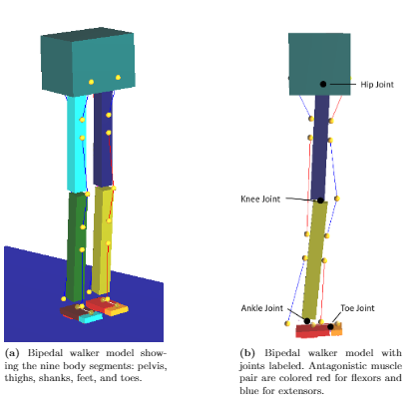
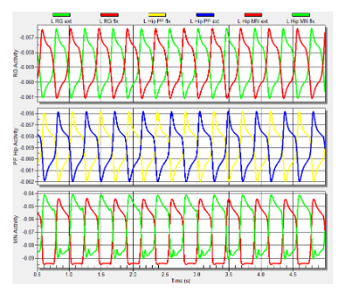
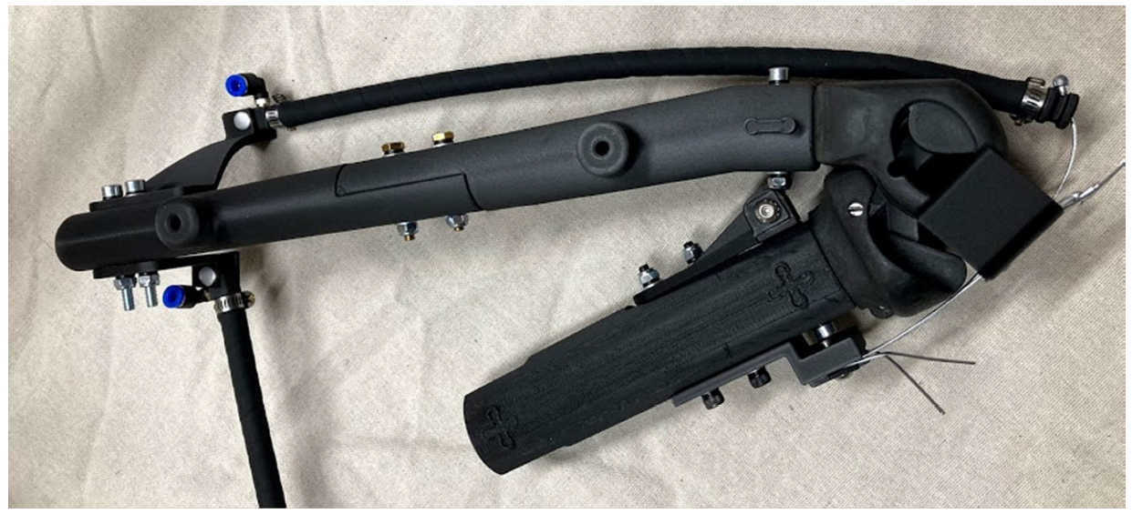
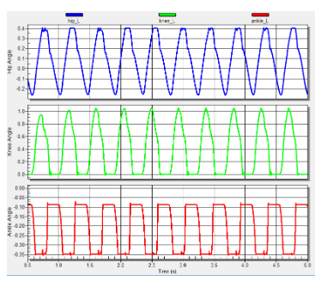
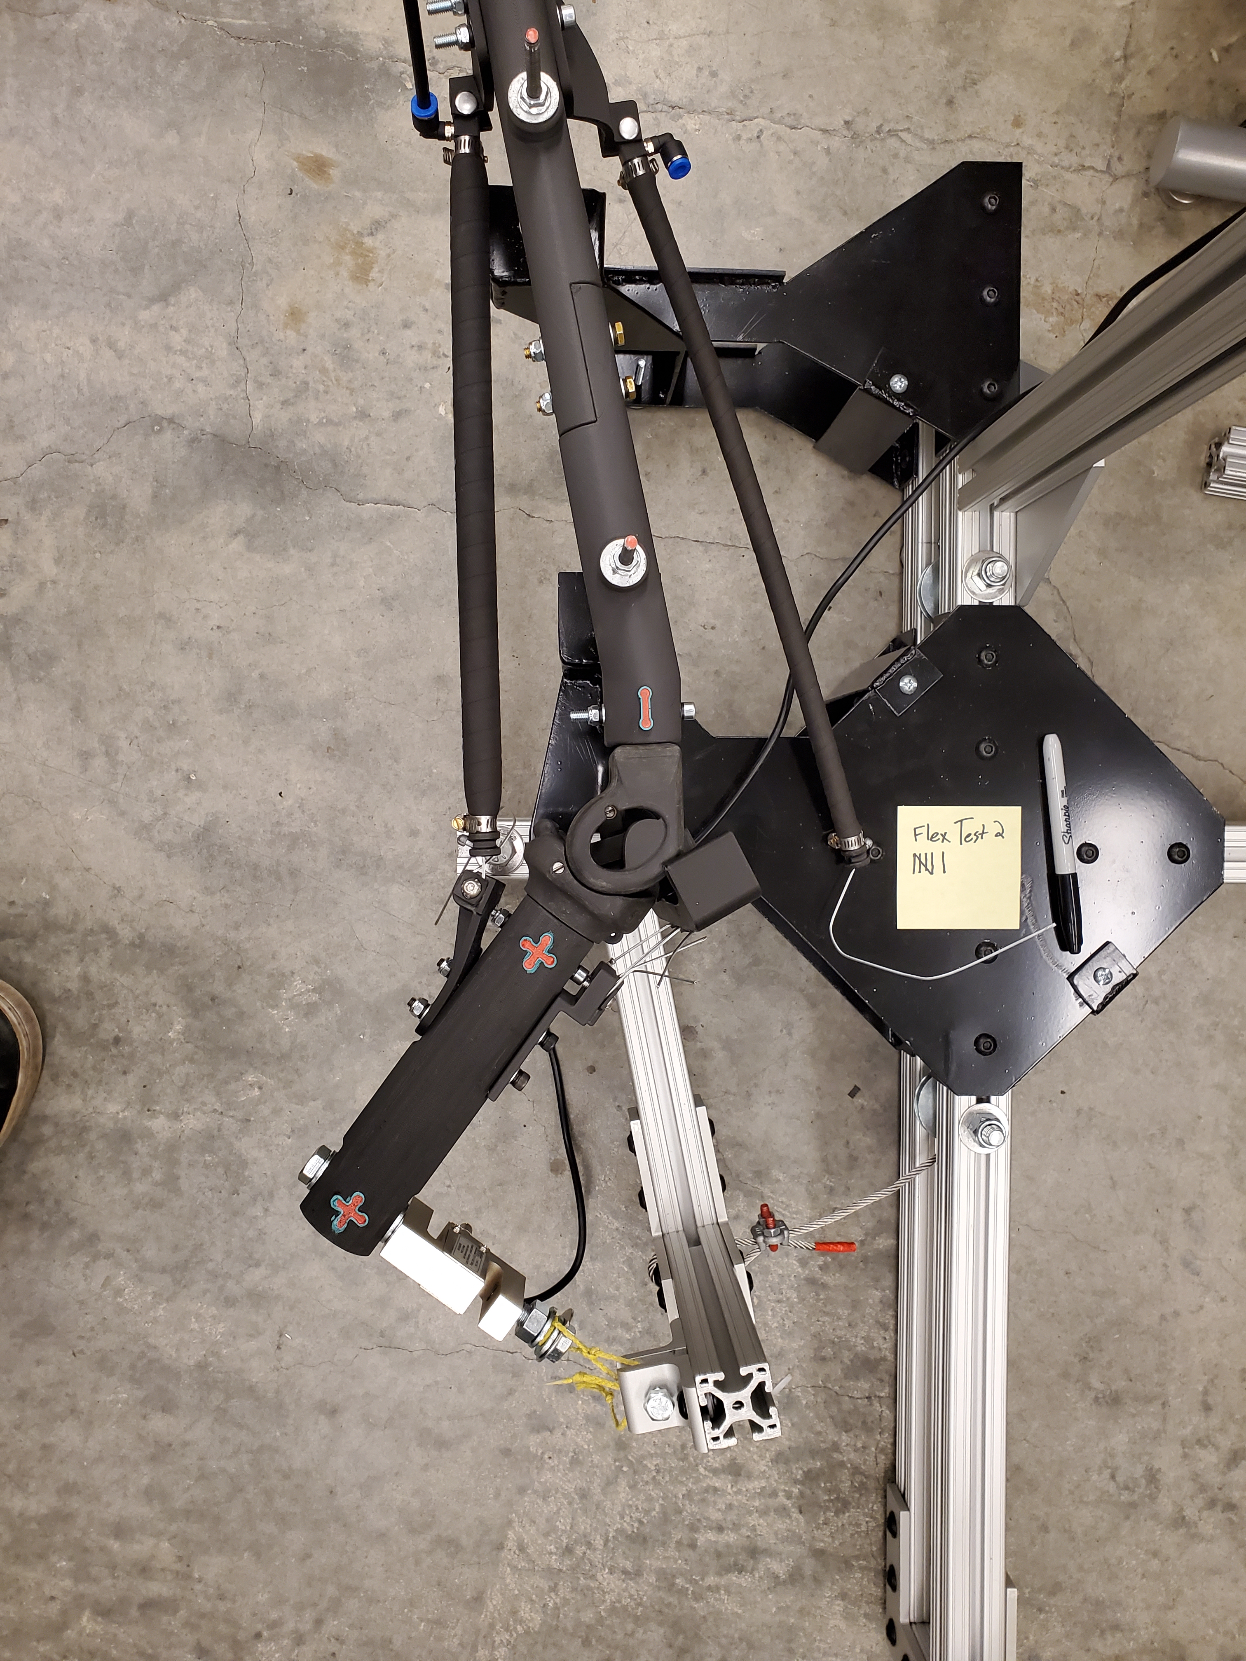
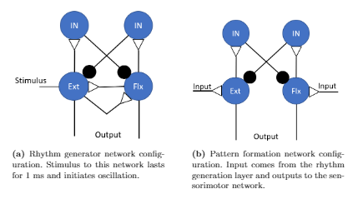
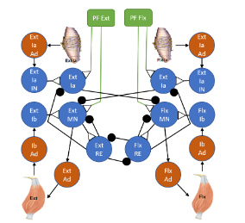
Torque Values About Artificial Knee Using
Braided Pneumatic Actuators
Ben Bolen¹, Alexander Hunt¹
1) Dept. of Mechanical and Materials Engineering, Portland State University, Portland, OR
Artificial Knee
We built an artificial knee to human scale. The translating and rotating knee joint was developed in a previous paper [1]. The assembly consists of one extensor and one flexor artificial muscle attached. The knee assembly is restrained in a jig to test for maximum isometric force about the joint for each muscle at various knee angles. These results are then to be compared to results obtained using theoretical calculations developed in our previous work [2].
Bipedal Walker
A neuromechanical model of a bipedal walker will be how the robot is controlled. This is done in Animatlab[3] software. The mechanical model, developed by Li[4] of the simplified walker model is shown below.
Results
The CPG is given a stimulus, and the neuronal and mechanical outputs are given below. Isometric torque test results will be released in the future. The end goal is to integrate a biomimetic neuromechanical model as a controller for the humanoid robot. These biomimetic robots will improve our understanding of neural control of locomotion.
Abstract
Neural control of locomotion is a complex process of sensing, processing, and acting that is not well understood. Greater understanding necessitates modeling biomechanics and neural circuits, and investigating how interactions between the nervous system, the body, and the environment result in effective movement and behaviors. Some of our previous work has been to design, from a biomechancial and engineering design approach, a bipedal biomimetic humanoid robot that is actuated by Festo-brand braided pneumatic actuators (BPAs) artificial muscles. BPAs can be used as artificial muscles because they have force-length curves grossly similar to real muscle. In our current work we build part of that robot (the knee, femur, and tibia), with uniarticular knee flexor and extensor BPAs, to test for the maximum isometric torque about the knee joint at various knee positions. However, previous experiments have only fully characterized the 10 mm diameter Festo BPA. Since our design uses 20 and 40 mm diameter Festo BPAs, we thought it important to fully characterize these BPA sizes and the results are included in this work. In the future we will compare the measured isometric torque values about the knee joint to the theoretical calculations developed in our previous work. The results of these experiments help in better modeling and designing biomimetic humanoid robots. Future work will also integrate these robots with neural controllers and feedback. Much of this current work revolves around humanoid robots but the results are broadly applicable to other biomimetic robots that use BPAs, including the quadruped robot our lab is working on.
Output from the rhythm generation layer (top), pattern formation layer (middle), and motor neurons in the sensorimotor layer (bottom).
3D printed leg assembly with femur, knee, tibia, patella. Extensor BPA is connected while the flexor BPA is disconnected.
CPG Architecture
The neural model has the 2-layer Central Pattern Generator (CPG) used by Deng[5].
3D printed leg assembly fixed in the test stand for isometric torque test. Flexor BPA is attached and inflated, while the extensor BPA is detached. Load cell is mounted at a right angle to the tibia and attached to a swing arm.
Angle of the body joints as they are stimulated: hip (top), knee (middle), and ankle (bottom).
Funding
NSF grant for NeuroNex: C3NS #2015317
NIH BUILD EXITO grant numbers 5RL5GM118963-06, 5TL4GM118965-06, 5RL5GM118963-07, and 5TL4GM118965-07
References
Steele, Alexander G., Alexander Hunt, and Appolinaire C. Etoundi. "Biomimetic knee design to improve joint torque and life for bipedal robotics." Annual Conference Towards Autonomous Robotic Systems. Springer, Cham, 2018.
Bolen, Ben P., and Alexander J. Hunt. "Determination of artificial muscle placement for biomimetic humanoid robot legs." Conference on Biomimetic and Biohybrid Systems. Springer, Cham, 2019.
Cofer, David, et al. "AnimatLab: a 3D graphics environment for neuromechanical simulations." Journal of neuroscience methods 187.2 (2010): 280-288.
Li, Wei, Nicholas S. Szczecinski, and Roger D. Quinn. "A neural network with central pattern generators entrained by sensory feedback controls walking of a bipedal model." Bioinspiration & biomimetics 12.6 (2017): 065002.
Deng, Kaiyu, et al. "Neuromechanical model of rat hindlimb walking with two-layer CPGs." Biomimetics 4.1 (2019): 21.
Example configuration of a sensorimotor network, which receives input from the pattern formation layer.

